Slide 1


Different Security Attacks in Healthcare IoT and Blockchain-Based Mitigation
Exploring how blockchain enhances data integrity, privacy, and trust in smart healthcare systems
Submitted By: Hridiyansh Shukla • 2427030591Supervised By: Dr. Usha JainSchool of Computer Science and EngineeringDepartment of Computer Science and Engineering

Slide 2
Presentation Roadmap
01
02
Introduction
Literature Review
Healthcare IoT landscape and emerging vulnerabilities
Security threats and existing mitigation approaches
03
04
Problem Statement
Proposed Solution
Research focus and key challenges
Blockchain-based security framework
05
06
Objectives
References
Research goals and expected outcomes
Supporting literature and citations

Slide 3

Healthcare IoT: A Double-Edged Sword
Transforming Patient Care
Healthcare IoT (H-IoT) encompasses interconnected medical devices that revolutionize patient monitoring and care delivery. These smart systems include:
Wearable health monitors tracking vital signs continuously
Implantable devices like pacemakers and insulin pumps
Remote patient monitoring systems enabling telemedicine
Hospital IoT networks managing equipment and patient data
Real-time monitoring, automated diagnostics, and remote care delivery improve outcomes while reducing costs.

Slide 4

The Vulnerability Challenge
Data Theft
Unauthorized Access
Sensitive patient records exposed through unauthorized access to networked devices
Malicious actors gaining control of critical medical equipment remotely
Ransomware
Healthcare systems held hostage, disrupting life-saving operations
These vulnerabilities create critical risks in healthcare delivery. Blockchain technology offers a promising path forward by ensuring security, immutability, and transparency in medical data management.

Slide 5
Common Security Attacks in Healthcare IoT
Man-in-the-Middle (MITM) Attacks
1
Attackers intercept communications between IoT devices and servers, capturing or manipulating sensitive medical data during transmission. Critical patient information becomes compromised without detection.
Distributed Denial-of-Service (DDoS) Attacks
2
Coordinated flooding of hospital networks and servers with traffic, rendering critical systems unavailable. Emergency departments and surgical units face life-threatening operational disruptions.
Data Breaches
3
Unauthorized access to centralized databases containing patient records, medical histories, and treatment plans. Stolen data may be altered, sold, or used for identity theft and insurance fraud.
Replay Attacks
4
Previously captured legitimate medical signals or commands are maliciously reused. Attackers can trigger false readings or inappropriate medical interventions by replaying authentic device communications.

Slide 6

Existing Mitigation Approaches and Their Limitations
Current Security Measures
Traditional healthcare IoT security relies on established cryptographic and network defense mechanisms:
End-to-end encryption for data in transit
Multi-factor authentication for device and user access
Intrusion Detection Systems (IDS) monitoring network traffic
Firewalls and access controls protecting perimeters
Critical Weakness: Centralization
Scalability Challenges
Trust Deficiency
Centralized architectures create single points of failure—compromising one server exposes entire patient populations
Traditional systems struggle to manage exponentially growing IoT device networks and data volumes efficiently
Centralized authorities controlling data create trust gaps—patients and providers question data integrity and access logs

Slide 7
Blockchain: A Decentralized Security Paradigm
Recent academic research demonstrates blockchain's potential to transform healthcare IoT security through distributed trust and immutability. Studies leveraging platforms like Hyperledger Fabric, Ethereum, and IOTA show promising results in securing medical data sharing.
Hyperledger Fabric
Ethereum Smart Contracts
IOTA for IoT
Permissioned blockchain enabling private healthcare consortiums with granular access controls and high transaction throughput
Programmable access policies automatically enforcing consent management and audit trails for patient data interactions
Feeless, scalable distributed ledger specifically designed for machine-to-machine transactions in resource-constrained devices

Slide 8
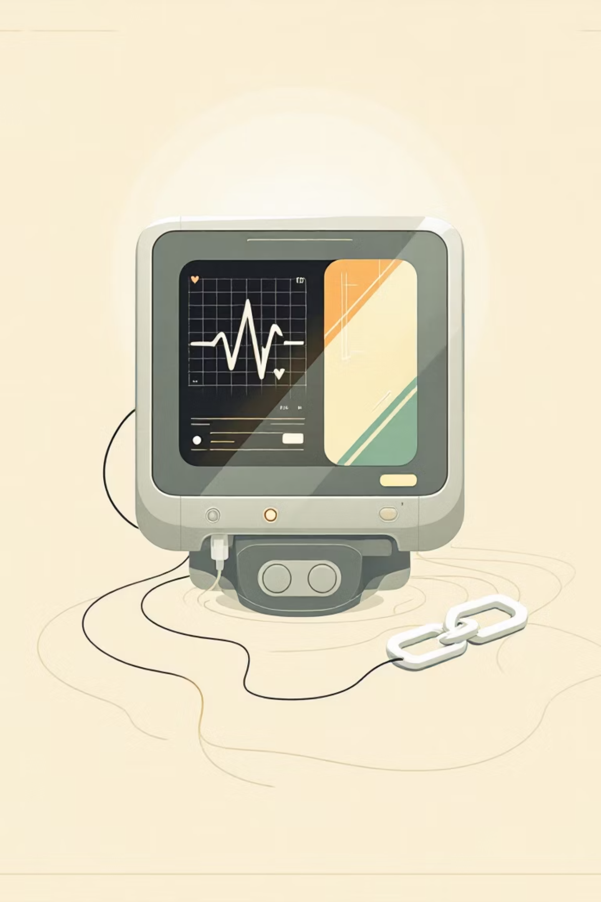
Problem Statement
To identify major security threats in Healthcare IoT systems and design a blockchain-based framework to enhance data security, integrity, and trust.
This research addresses the critical gap between rapidly expanding healthcare IoT deployments and inadequate security infrastructures, proposing blockchain as a fundamental architectural component rather than an afterthought.

Slide 9





Proposed Blockchain-Based Security Framework
IoT Data Collection
Smart devices continuously monitor and collect patient health data
Encryption Layer
Data encrypted before blockchain submission using advanced cryptographic protocols
Consensus Verification
Transactions validated through distributed consensus mechanisms (PoW/PoS)
Smart Contract Access Control
Automated permissions manage who can view or modify patient records
Immutable Storage
Tamper-proof ledger ensures permanent, auditable data integrity
Blockchain Mitigation of Specific Attacks
MITM Protection
DDoS Resilience
Breach Prevention
Replay Defense
End-to-end encryption with cryptographic authentication prevents interception
Decentralized architecture eliminates single points of failure
Immutable ledger makes unauthorized data alteration detectable
Timestamped blockchain blocks prevent command reuse

Slide 10





Research Objectives
Threat Classification
Systematically study and categorize major security threats in Healthcare IoT systems, analyzing attack vectors, vulnerabilities, and potential impact on patient safety
Blockchain Security Techniques
Explore and evaluate blockchain-based approaches for enhancing confidentiality, data integrity, and multi-party authentication in distributed healthcare environments
Secure Architecture Design
Develop a comprehensive security architecture integrating IoT medical devices with blockchain infrastructure, addressing scalability, latency, and regulatory compliance
Risk Reduction Evaluation
Quantitatively assess how blockchain implementations reduce risks from MITM attacks, DDoS threats, data tampering, and unauthorized access in real-world scenarios

